Slide 1
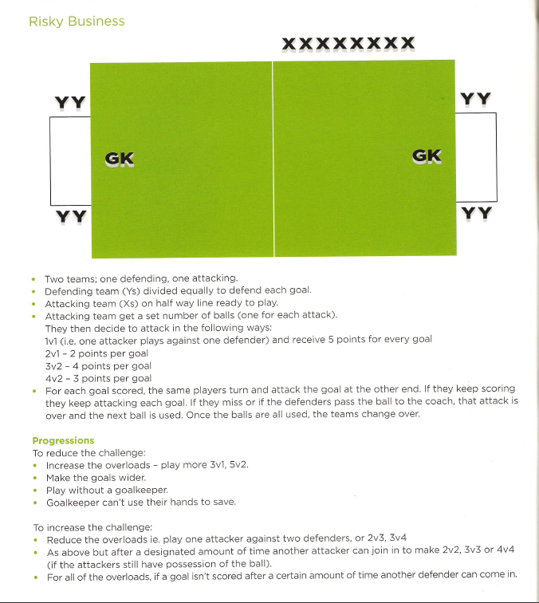
Attacking & Defending - Risky Business

